Slide 1
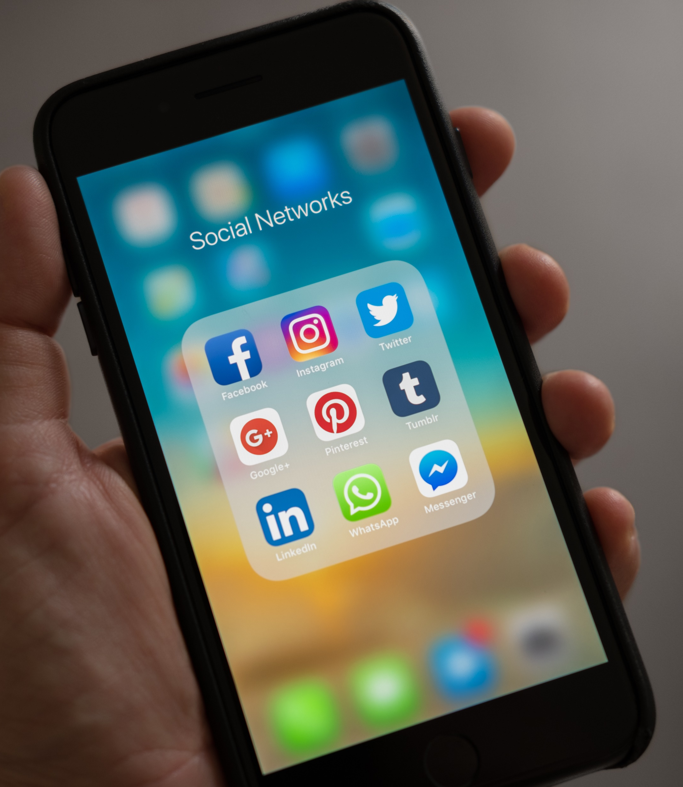
The 10 Apps That App Trader should purchase

Slide 2
Criteria Used
Both App store and Play Store
Content Rating No Matured Apps
Total amount of Reviews
Choose Apps With in App Purchases
Reviews 3.5 And Higher

Slide 3
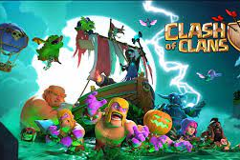
Clash of Clans
Price: Free
Rating 4.5
Investment 25,000$ + 1000$/month
Profits:5000$ Per Month – 1000$ per Month, Yearly income after Advertisement 48,000$ per year
After 9 years it would be 432,000$ in Profit

Slide 4
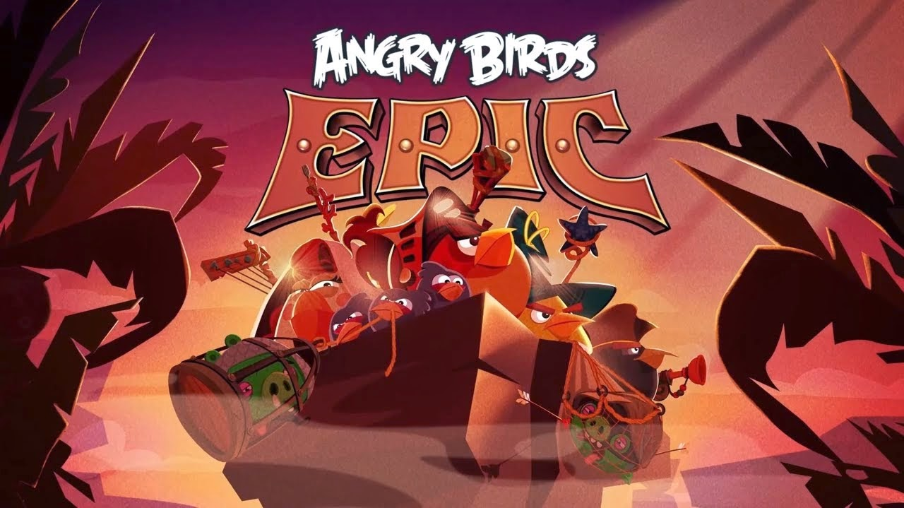
Angry birds
Price: Free
Rating: 4.5 stars
Investments: $25,000 + $1000 per Month

Slide 5
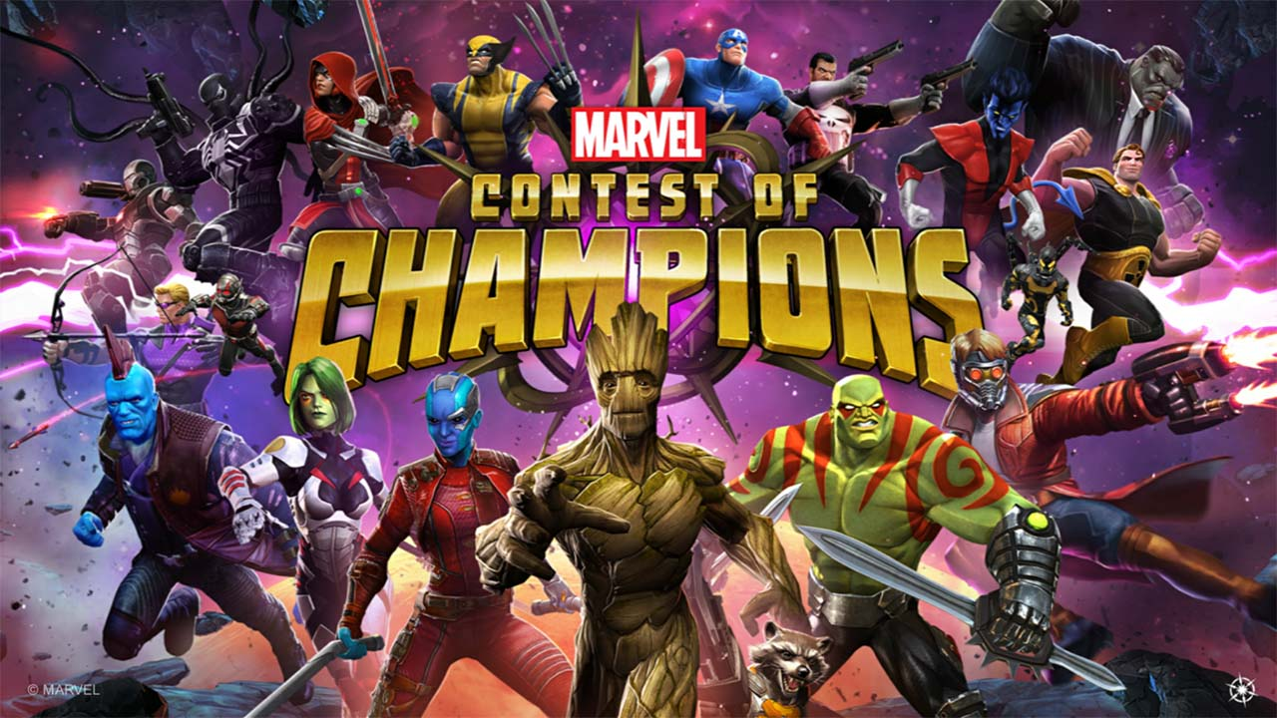
Marvel Contest of champions
Price: Free
Rating: 4.4 stars
Investments: $25,000 + $1000 per Month
This Photo by Unknown Author is licensed under CC BY-NC

Slide 6
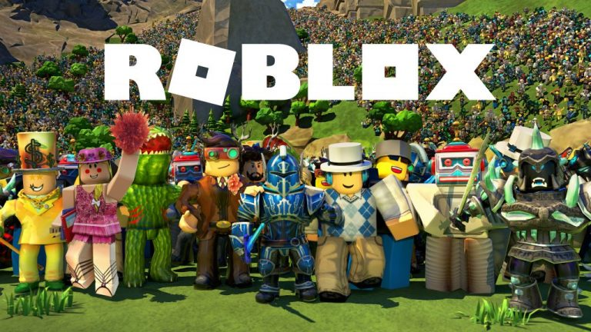
ROBLOX
Price: Free
Rating: 4.5 stars
Investments: $25,000 + $1000 per Month
This Photo by Unknown Author is licensed under CC BY

Slide 7

Summoners war
Price: Free
Rating: 4.5 stars
Investments: $25,000 + $1000 per Month
This Photo by Unknown Author is licensed under CC BY-SA

Slide 8
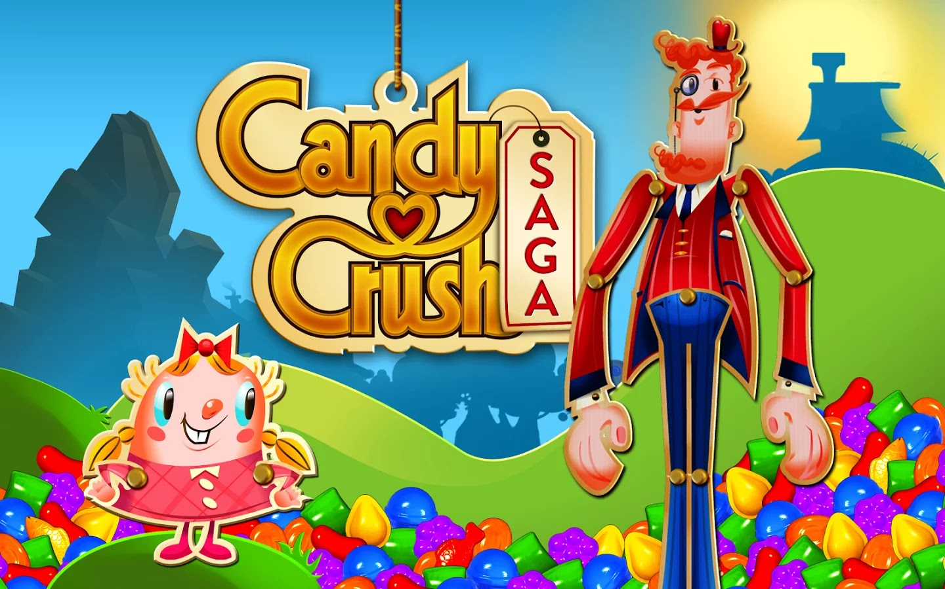
Candy crush saga
Price: Free
Rating: 4.4 stars
Investments: $25,000 + $1000 per Month
This Photo by Unknown Author is licensed under CC BY

Slide 9

Subway sufers
Price: Free
Rating: 4.5 stars
Investments: $25,000 + $1000 per Month
This Photo by Unknown Author is licensed under CC BY

Slide 10
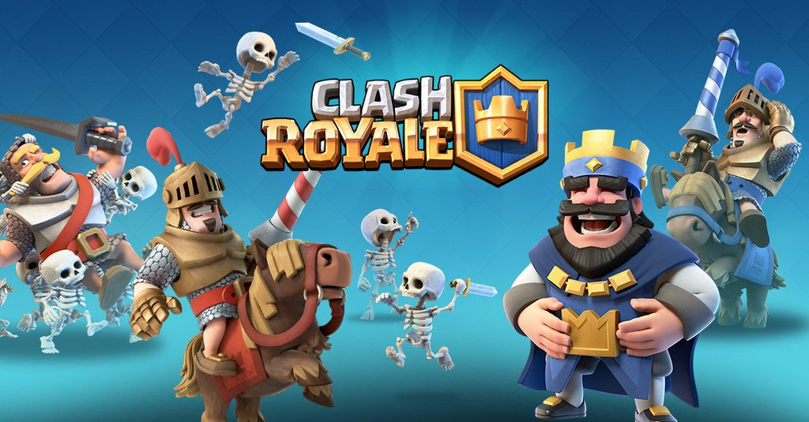
Clash royal
Price: Free
Rating: 4.6 stars
Investments: $25,000 + $1000 per Month
This Photo by Unknown Author is licensed under CC BY-SA

Slide 11

Temple run 2
Price: Free
Rating: 4.5 stars
Investments: $25,000 + $1000 per Month

Slide 12
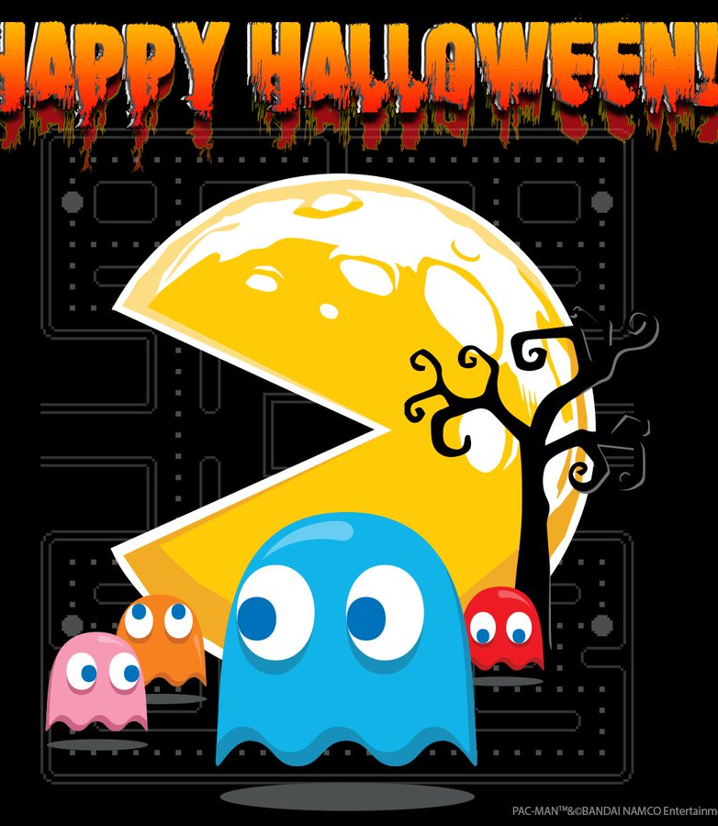
PAC-MAN
Price: Free
Rating 3.6
Invest 25,000$ +1000/month

